Slide 1

A Presentation on…..
Indian Cafe
PRESENTED BY:
P.Sathish kumar
Batch: 2021-5723

Slide 2
CONTENT
Intrudction
Requirements For Implementation
Containing Pages
Results
Conclusion

Slide 3
INTRUDCTION
A café is a type of restaurant which typically serves coffee and tea, in addition to light refreshments such as baked goods or snacks. The term "café" comes from the French word meaning "coffee".
In my café we are provides different types of ‘coffees’ and ‘teas’. among with we are provides ‘foreign coffees and teas’ also.
In my café there is a three members are playing major role
they are Mr shreef(master), Mr waseem(supervisor) and Mr sathishkumar(manager).

Slide 4
Requirements for Implementation
Coding Languages: HTML,CSS and JS
Operating System: Windows
Text Editor: Sublime
Browser: Chrome
Data fetching: from browser

Slide 5
Containing Pages
Home page:
In this page we see the café poster and Title.
we also see the logo at left top corner and also navigation buttons at right top corner.
Menu Page:
in this page we see the menu list of both coffee and tea’s.
We are provides different types of indian coffees and tea’s and also foreign coffees and tea’s.

Slide 6
About page:
In this page we are simply describe our café.
And also introduce master,supervisor and manager among with their details.
Contact page:
Here we are provides contact details.
Also provide Customer details form

Slide 7
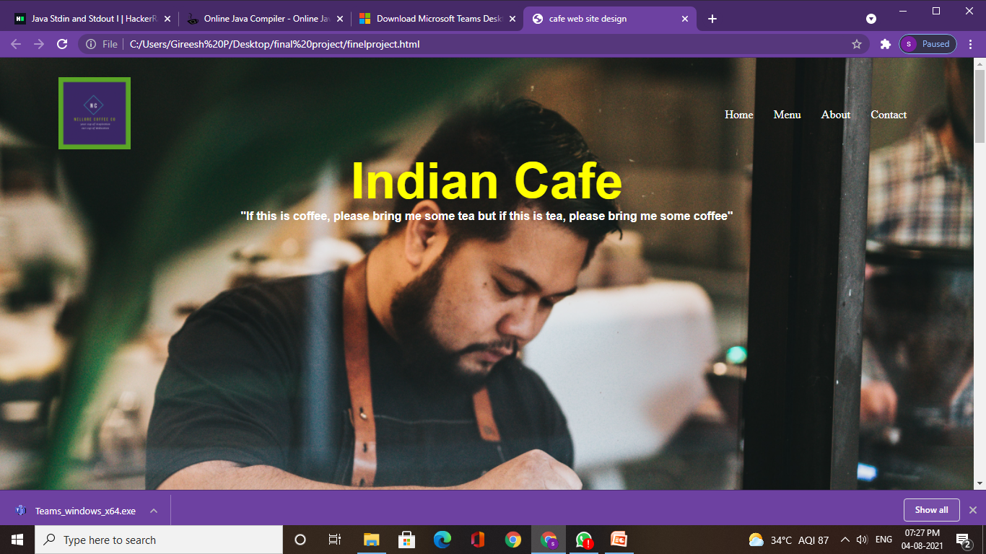
RESULTS
Home page:

Slide 8
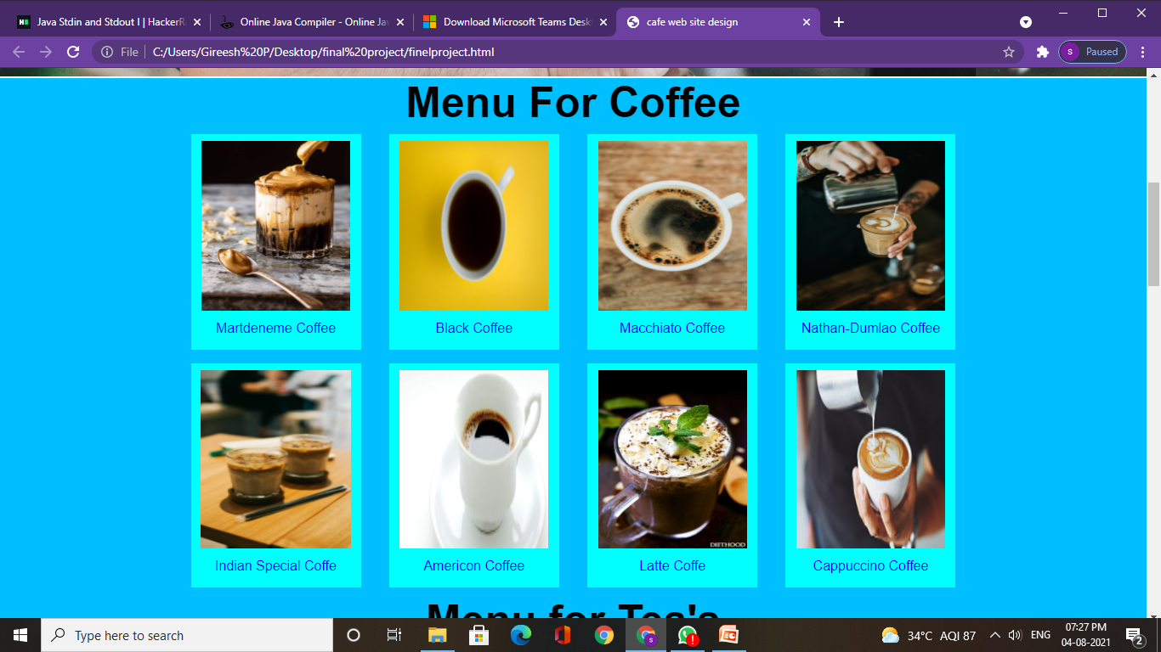
Memu page: (continue)

Slide 9
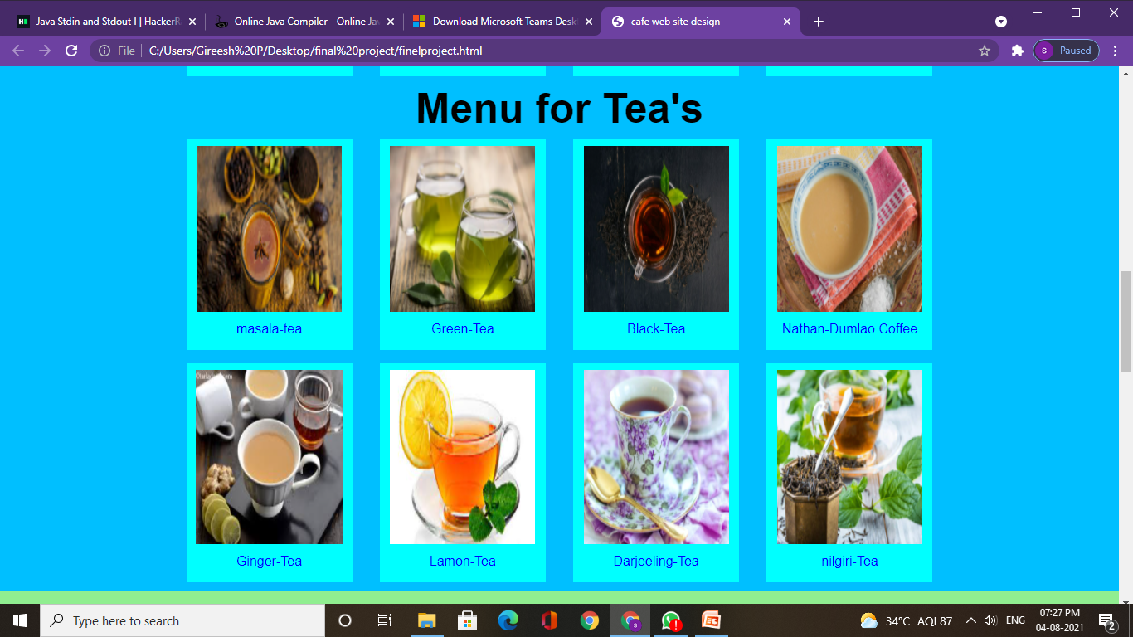
Memu page:

Slide 10
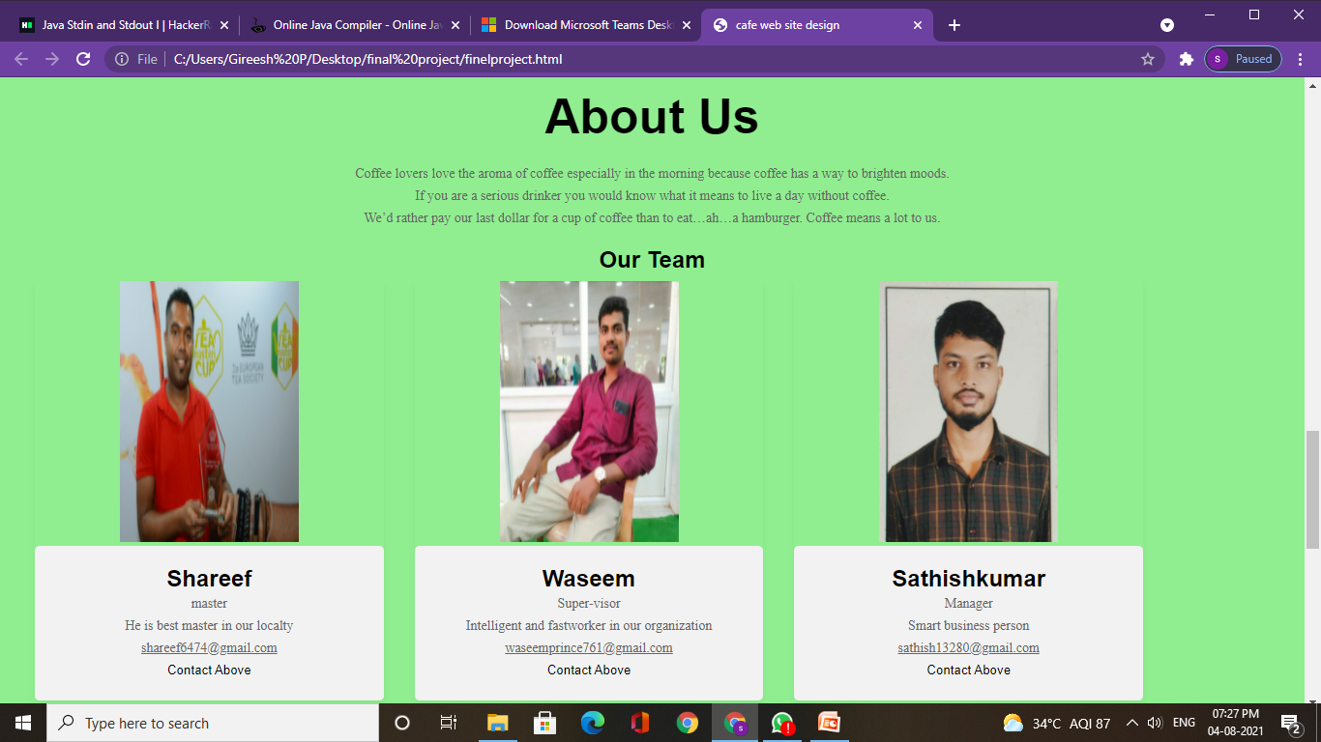
About page:

Slide 11
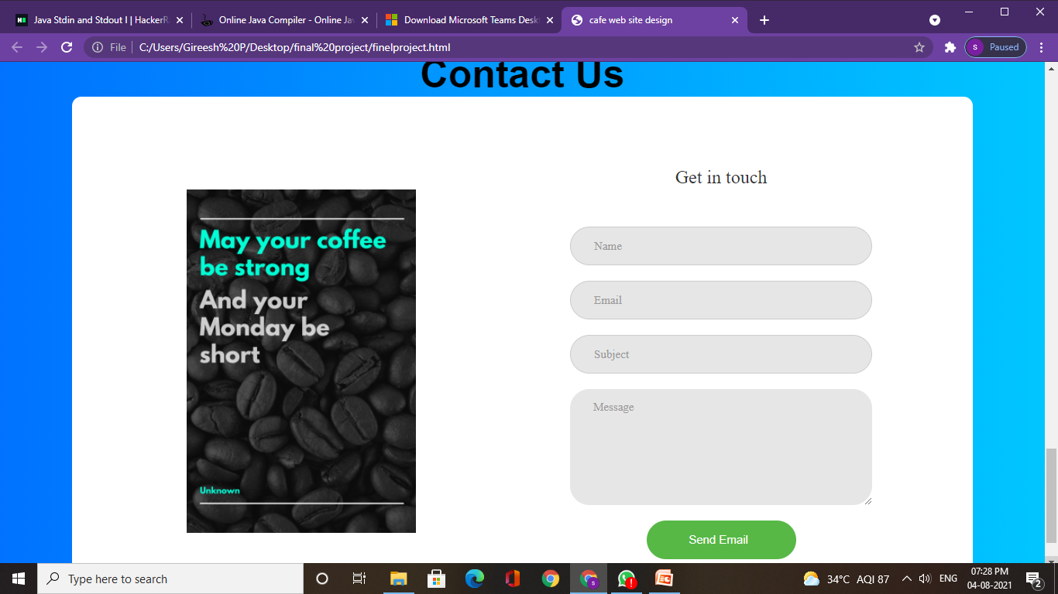
Contact page:

Slide 12
CONCLUSION
My café is the best café in our locality. Comparing to all other cafes we are providing various types and special items and also we got five star rating from food inspection team.

Slide 13
Thank You

